Slide 1
Part 4:
Machine learning performance metrics
Classification models
Model optimisation
Performance metrics

Slide 2
Lesson concepts
Performance metrics
Confusion matrices
False negatives, true negative, false positives, true positives
Specificity and sensitivity
ROC curves
Performance metrics

Slide 3
Performance measures for classification
Accuracy:
Number of correct predictions x 100
Total number of predictions

Slide 4

Accuracy - quick practise
Training a model
Outputting the accuracy for train and test

Slide 5
Accuracy
Accuracy is a no-no if:
You have significantly unbalanced classes in your dependent variable
If there is a high importance for your classes to not be mis-classified

Slide 6
Other performance metrics
Precision
Recall
F1 score
ROC-AUC score
Sensitivity vs specificity

Slide 7
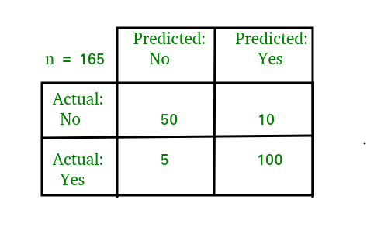
Confusion matrix
True positives (predict pos, true)
False positives (predict pos, false)
True negatives (predict neg, true)
False negatives (predict neg, false)

Slide 8
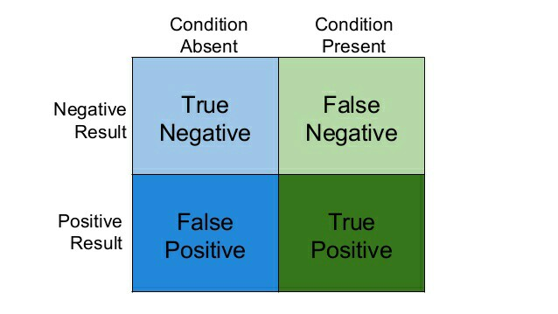
False positives
False negatives
True positives
False positives
True negatives
False negatives
Who can provide an example of each in the context of judge bot - sentencing people to prison or not (y) based on available evidence (x_{n})

Slide 9

Another example
Medical diagnosis - diagnosing people with malaria

Slide 10
Let’s create a confusion matrix
Running a logistic regression model
Outputting the outcomes of the predictions from our fit(X_test) based on the ground truth (y_test)

Slide 11
Classification performance measures
We’ve already gone over accuracy. What other measures might you intuitively think of?

Slide 12
Classification performance measures
Precision
Recall
F1 score
ROC
Sensitivity
Specificity

Slide 13
Precision
Potential reasons:
Observational error
Data entry error
Naturally occurring outlying data
Precision = TP/(TP + FP)
Precision cares about how well the positives are being classed (if there were no FP, precision would be a perfect 1)
Calculate the precision for the above confusion matrix

Slide 14
Recall
Potential reasons:
Observational error
Data entry error
Naturally occurring outlying data
Recall = TP/TP + FN
Otherwise known as sensitivity. Prioritising avoiding False negatives
Calculate the Recall for the above confusion matrix

Slide 15
F1 score
Potential reasons:
Observational error
Data entry error
Naturally occurring outlying data
F1 Score = 2 x (precision*recall) / (precision+recall)
The ‘harmonic mean’ of precision and recall - basically a nice representation of the two
Calculate the precision for the above confusion matrix
Precision = TP/TP + FP
Recall = TP/TP + FN

Slide 16
How do we calculate these with python?
Sklearn - Classification_report makes it very easy

Slide 17

Sensitivity
and
specificity
Sensitivity (True Positive rate) measures the proportion of positives that are correctly identified. How much fraud did we catch?
Specificity (True Negative rate) measures the proportion of negatives that are correctly identified. How many good customers did we correctly detect?

Slide 18
Sensitivity
and
specificity
What would it mean if you had a model which could classify people who will pay their arrears on time, but performs poorly on correctly classifying those who don’t pay on time?

Slide 19
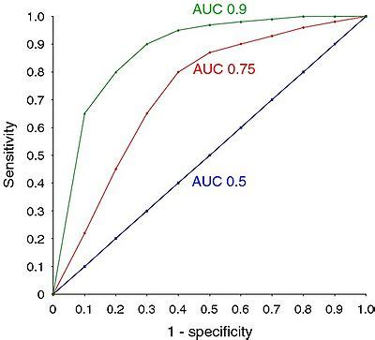
ROC curve - AUC
Who wants to have a try at interpreting this?
Is a high AUC good or bad?
ROC - Receiver operating characteristic curve
AUC - Area under the curve
TPR (how much fraud detected) vs FPR (how many good customers incorrectly classified as fraud)

Slide 20
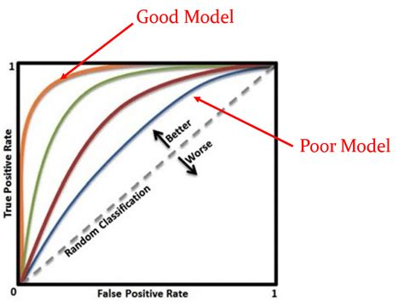
AUC-ROC
An ‘ROC score’ is generally our go to when we’re concerned about unbalanced classes

Slide 21
AUC ROC
Running logistic regression
Obtaining an ROC score for train/test
Plotting an ROC curve so that we can visualise and interpret it

Slide 22
Revision
Accuracy
Precision
Recall
F1
Sensitivity
Specificity
ROC curve - AUC

